Slide 1
Get Walk Location Service
High-Level UI Walkthrough

Slide 2
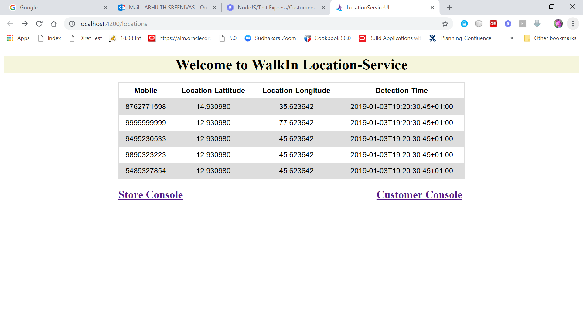
Location Service Home Screen
Notes:
This is the Home Page with Customers with Location Data.
Click on Store Console for Launch Store Lists.

Slide 3
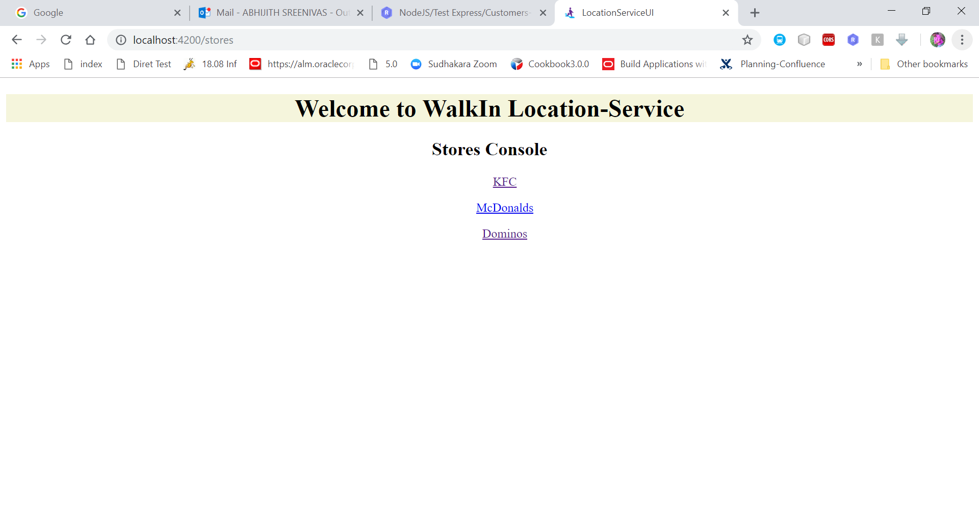
Store List Screen
Notes:
Click on any of the Store and launch Store Home Page.

Slide 4
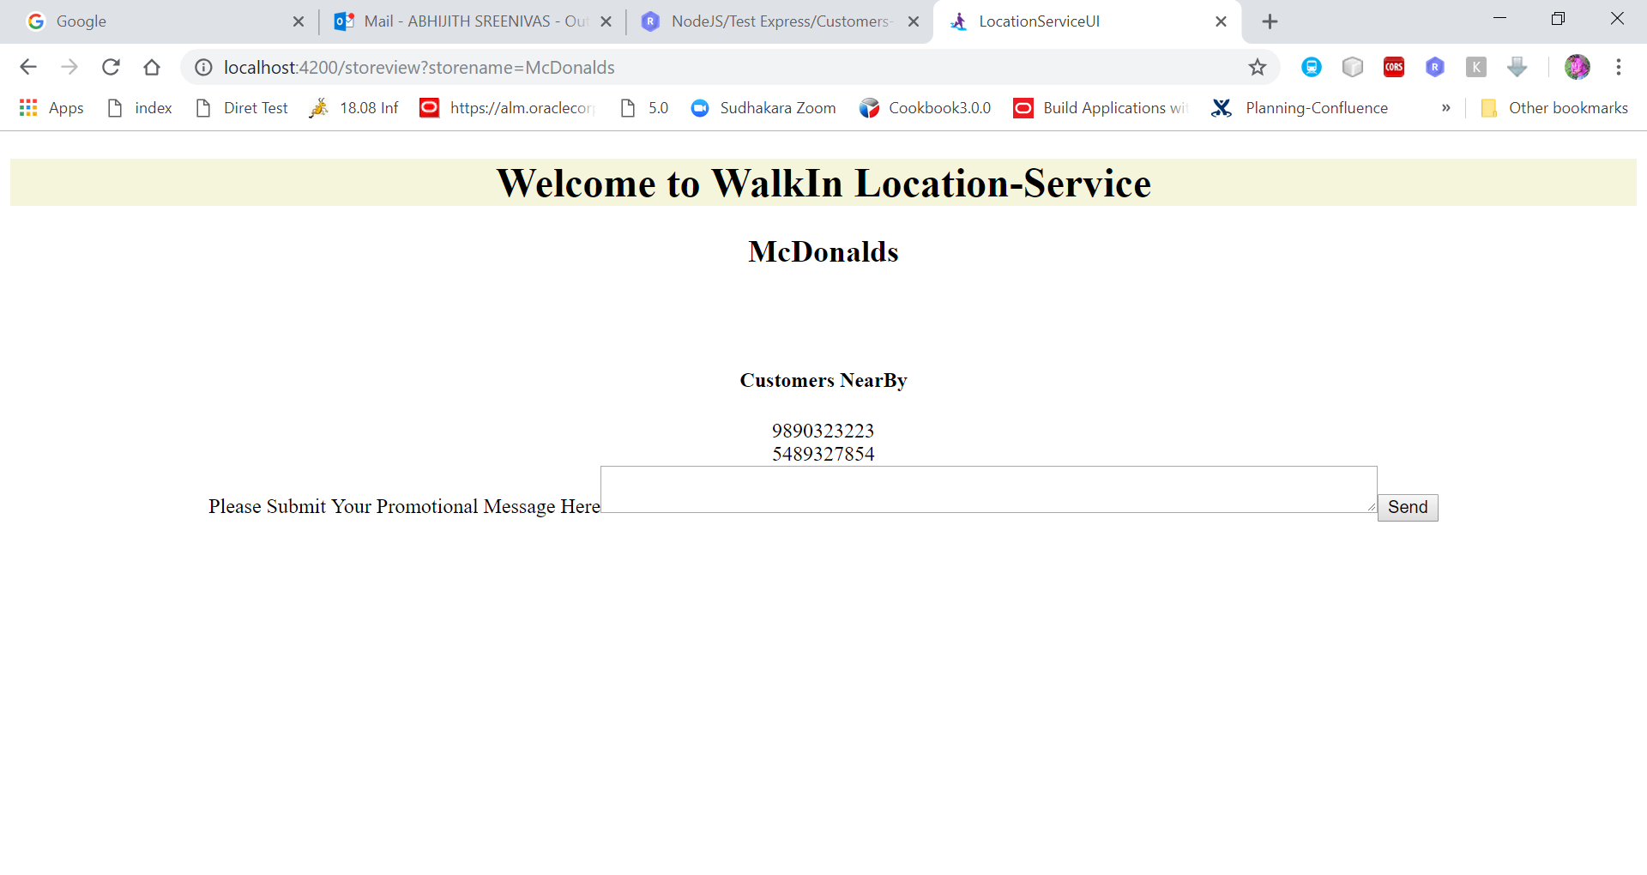
Store Home Page
Notes:
Available Customers in the Same Geographical Region can be seen.
User can Put their promotional message and send.
Can Enhance this UI for scheduled messages as mentioned in case study.

Slide 5
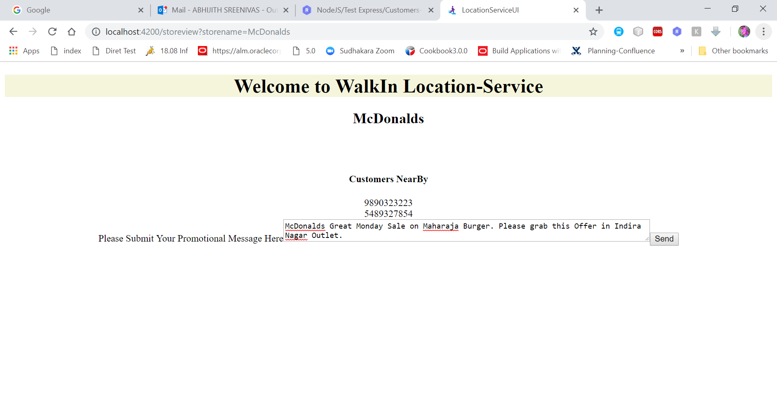
Store Home Page
Notes:
Available Customers in the Same Geographical Region can be seen.
User can Put their promotional message and send.
Can Enhance this UI for scheduled messages as mentioned in case study.

Slide 6
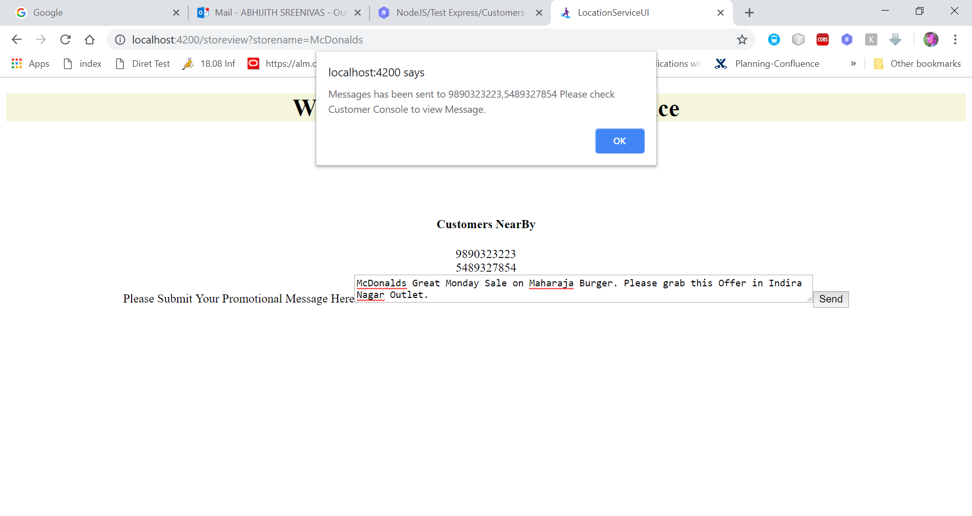
Store Home Page –Acknowledge for Message Sent
Notes:
Navigate to Home Screen
Click on Customer Console ()

Slide 7
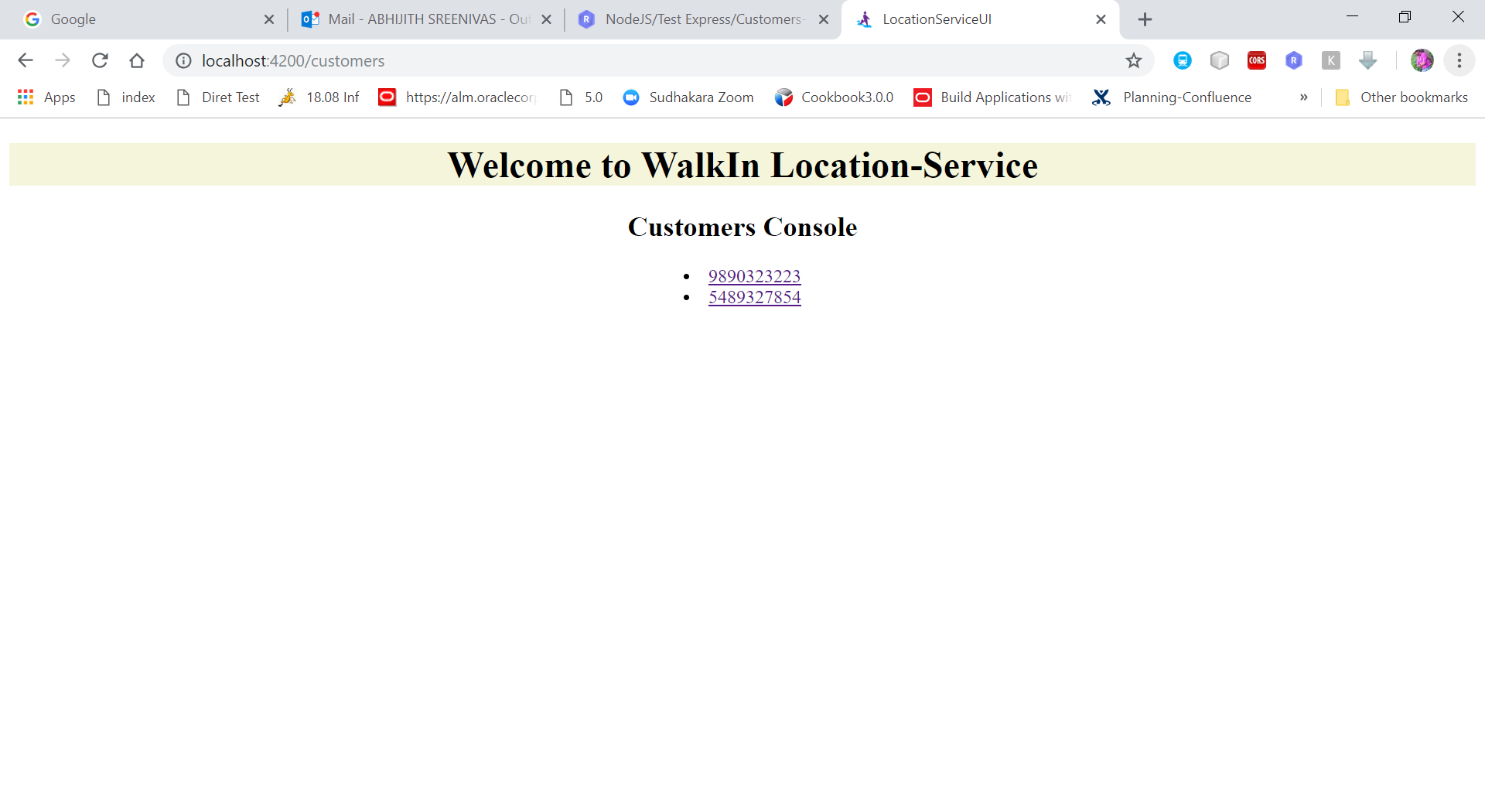
Customer List Page
Notes:
Click on any customer to see Customer Home Page Screen

Slide 8
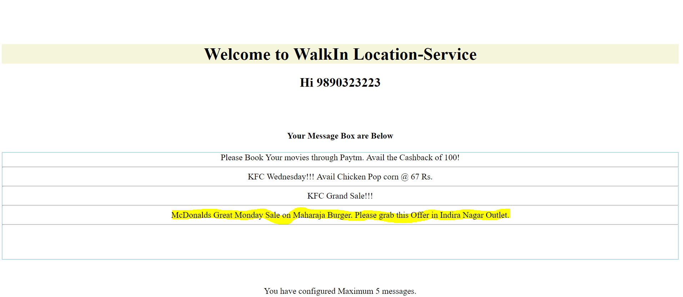
Customer Home Page
Notes:
You can see the messages there. Maximum Configured Messages also.

